Slide 1
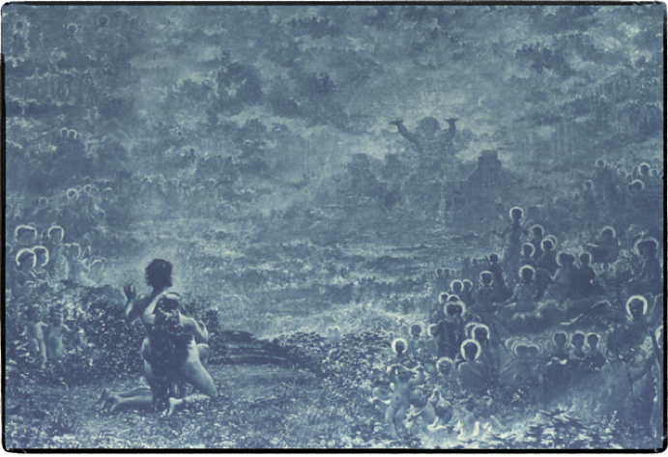
GOD’S STORY
Discovering YOUR Part in God’s SUPERNATURAL PLAN
Introduction

Slide 2
The Scream
by Edvard Munch

Slide 3
GOD’S STORY
Discovering YOUR Part in God’s SUPERNATURAL PLAN
1. Before Creation
2. After Creation
3. The Flood
4. The Tower of Babel
5. The Kingdom of Israel
6. The Cloud Rider
7. The Kingdom of God

Slide 4
GOD’S STORY
Discovering YOUR Part in God’s SUPERNATURAL PLAN
Biblical Thoughtful
Culturally Relevant
Spiritually Powerful

Slide 5
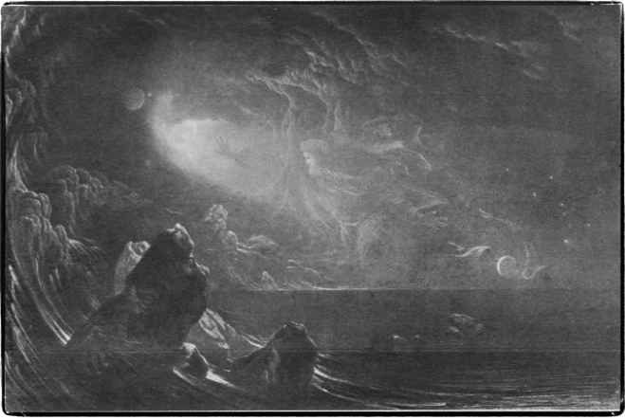
GOD’S STORY
Discovering YOUR Part in God’s SUPERNATURAL PLAN
BEFORE CREATION
Unless otherwise noted, artwork is from Charles Holms and Julius Bewer. The Bible and Its Story, Volumes 1-8.
New York, NY: Francis R. Niglutsch, 1908.

Slide 6
Before Creation Existed
My King
But God has been my king from long ago,
working salvation in the midst of the earth.
Psalms 74:12*
Unless otherwise noted, all scripture references are from W. Hall Harris III et al., eds., The Lexham English Bible, Bellingham, WA: Lexham Press, 2012.

Slide 7
Before Creation Existed Leviathan
You split open the sea by your strength;
You broke the heads of the sea monsters in the waters.
You crushed the heads of Leviathan;
you gave him as food to the desert dwelling creatures.
You split open spring and wadi.
You dried up ever-flowing rivers.
Yours is the day, yours is the night also.
You established light and the sun.
You defined all the boundaries of the earth;
Summer and winter—you formed them.
Psalms 74:12–17

Slide 8
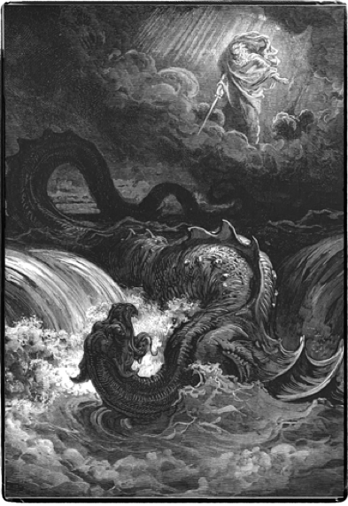
The Promise
On that day, Yahweh will punish with his cruel, great and strong sword Leviathan, the fleeing serpent, and Leviathan, the twisting serpent, and he will kill the sea monster that is in the sea.
Isaiah 27:1

Slide 9
Before Creation Existed the Sons of God
Where were you at my laying the foundation of the earth?
Tell me, if you possess understanding.
Who determined its measurement? Yes, you do know.
Or who stretched the measuring line upon it?
On what were its bases sunk?
Or who laid its cornerstone,
when the morning stars were singing together
and all the sons of God shouted for joy?
Job 38:4–7

Slide 10
“The Heavenly Host”
The sentence is by the decree of the watchers,
and the decision by the command of the holy ones.
Daniel 4:17
‘I will ascend to heaven;
I will raise up my throne above the stars of God;
and I will sit on the mountain of assembly…
Isaiah 14:13
God stands in the divine assembly;
he administers judgment in the midst of the gods.
Ps 82:1
And it happened one day that the sons of God came to present themselves before Yahweh,
Job 1:6

Slide 11
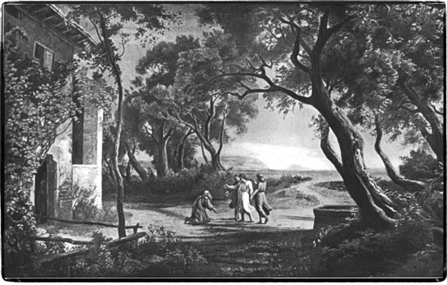
Before Creation Existed the The Word
After these things the word of Yahweh came to Abram in a vision,
Genesis 15:1

Slide 12
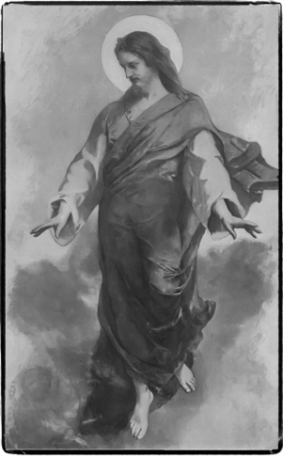
The Word
In the beginning was the Word, and the Word was with God, and the Word was God…
John 1:1
And the Word became flesh and took up residence among us, and we saw his glory, glory as of the one and only from the Father
John 1:14

Slide 13
BEFORE CREATION
Leviathan - Sons of God - The Word

Slide 14
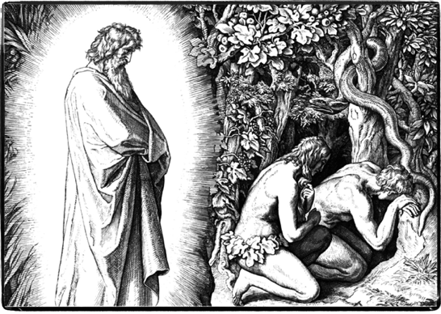
GOD’S STORY
Discovering YOUR Part in God’s SUPERNATURAL PLAN
AFTER CREATION
Stolen Identity

Slide 15
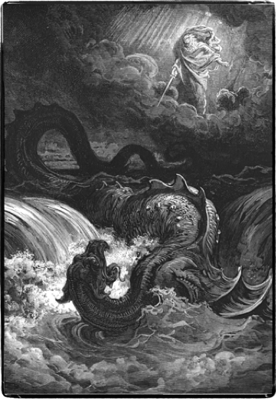
BEFORE CREATION
Leviathan
Sons of God
The Word
Time
The Promise
On that day, Yahweh will punish with his cruel, great and strong sword Leviathan, the fleeing serpent, and Leviathan, the twisting serpent, and he will kill the sea monster that is in the sea. Isaiah 27:1

Slide 16
AFTER CREATION
And God said, “Let us make humankind in our image and according to our likeness and let them rule over the fish of the sea, and over the birds of heaven, and over the cattle, and over all the earth, and over every moving thing that moves upon the earth.”
So God created humankind in his image, in the likeness of God he created him, male and female he created them.
And God blessed them, and God said to them, “Be fruitful and multiply, and fill the earth and subdue it, and rule over the fish of the sea and the birds of heaven, and over every animal that moves upon the earth
Genesis 1:26-28

Slide 17
IDENTITY
And God said, “Let us make humankind in our image and according to our likeness…
So God created humankind in his image, in the likeness of God he created him, male and female he created them.
Righteousness - Made the Right Way.

Slide 18
DESTINY
…let them rule over the fish of the sea, and over the birds of heaven, and over the cattle, and over all the earth, and over every moving thing that moves upon the earth…
…Be fruitful and multiply, and fill the earth and subdue it, and rule…
Kingdom - Actively rule as God’s representatives

Slide 19
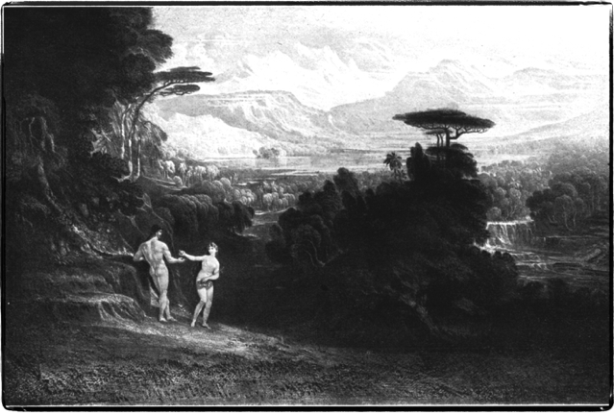
The Garden of Eden
Heaven on Earth
Eden
GOD’S SPACE
OUR SPACE

Slide 20
The Nachash
And the word of Yahweh came to me, saying, “Son of man, raise a lament over the king of Tyre, and you must say to him, ‘thus says the Lord Yahweh:
“You were a perfect model of an example,
full of wisdom and perfect of beauty.
You were in Eden, the garden of God, …
You were an anointed guardian cherub,
and I placed you on God’s holy mountain;
you walked in the midst of stones of fire.
You were blameless in your ways
from the day when you were created,
until wickedness was found in you…
and I cast you as a profane thing from the mountain of God,
and I expelled you, the guardian cherub,
from the midst of the stones of fire.
All who know you among the peoples
are appalled over you;
you have become as horrors,
and you shall cease to exist forever.”
Ezekiel 28:11–10

Slide 21
Stolen Identity
Now the serpent (nachash) was more crafty than any other wild animal which Yahweh God had made. He said to the woman, “Did God indeed say, ‘You shall not eat from any tree in the garden’?”
The woman said to the serpent, “From the fruit of the trees of the garden we may eat, but from the fruit of the tree that is in the midst of the garden, God said, ‘You shall not eat from it, nor shall you touch it, lest you die’.”
But the serpent said to the woman, “You shall not surely die. For God knows that on the day you both eat from it, then your eyes will be opened and you both shall be like gods, knowing good and evil.”
Genesis 3:1–5
[So God created humankind in his image, in the likeness of God he created him, male and female he created them.]

Slide 22
Follow God or some other spirit?
And Yahweh God said, “Look—the man has become as one of us, to know good and evil. What if he stretches out his hand and takes also from the tree of life and eats, and lives forever?”
And Yahweh God sent him out from the garden of Eden, to till the ground from which he was taken.
Ge 3:22-23

Slide 23
Why do bad things happen?
1. Putting our desires first
2. Wicked spirits rebelling
3. When we believe and act on lies about our identity and destiny
4. When we turn to other spirits instead of God for knowledge
5. Natural chaotic forces (Leviathan)
Who will fix this?

Slide 24
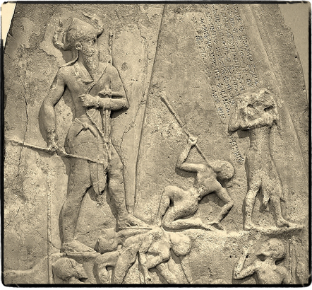
GOD’S STORY
Discovering YOUR Part in God’s SUPERNATURAL PLAN
THE FLOOD
Divine Intervention, Bad and Good

Slide 25
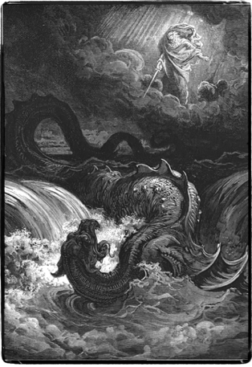
Leviathan
Sons of God
The Word
Time
Eden
Stolen Identity
The Promise
On that day, Yahweh will punish with his cruel, great and strong sword Leviathan, the fleeing serpent, and Leviathan, the twisting serpent, and he will kill the sea monster that is in the sea. Isaiah 27:1

Slide 26
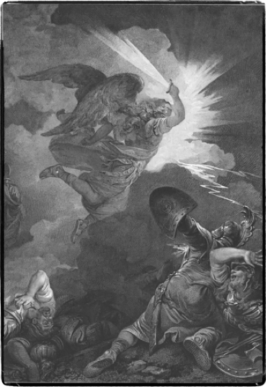
Cosmic War
And I will put hostility
between you and between the woman,
and between your offspring and between her offspring;
he will strike you on the head,
and you will strike him on the heel.”
Genesis 3:15

Slide 27
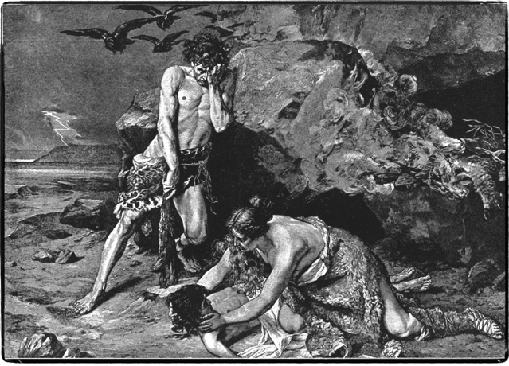
Spiritual War
Cain
(serpent’s offspring)
Abel
(her offspring)

Slide 28
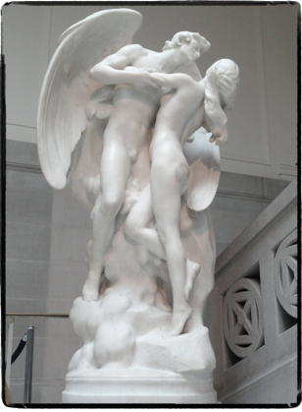
The Sons of God and their Human Wives
And the Giants
And it happened that, when humankind began to multiply on the face of the ground, daughters were born to them. Then the sons of God saw the daughters of humankind, that they were beautiful. And they took for themselves wives from all that they chose…
The Nephilim (giants) were upon the earth in those days, and also afterward, when the sons of God went into the daughters of humankind, and they bore children to them. These were the mighty warriors that were from ancient times, men of renown. Genesis 6:1–4

Slide 29
Bad Divine Intervention
And it came to pass when the children of men had multiplied that in those days were born unto them beautiful and comely daughters. And the angels, the children of the heaven, saw and lusted after them, and said to one another: ‘Come, let us choose us wives from among the children of men and beget us children.’
And they were in all two hundred; who descended in the days of Jared on the summit of Mount Hermon and they called it Mount Hermon, because they had sworn and bound themselves by mutual imprecations upon it…
And all the others together with them took unto themselves wives, and each chose for himself one, and they began to go in unto them and to defile themselves with them, and they taught them charms and enchantments, and the cutting of roots, and made them acquainted with plants.
And they became pregnant, and they bare great giants… Who consumed all the acquisitions of men. And when men could no longer sustain them, …The giants turned against them and devoured mankind. And they began to sin against birds, and beasts, and reptiles, and fish, and to devour one another’s flesh, and drink the blood…
And Azâzêl taught men to make swords, and knives, and shields, and breastplates, and made known to them the metals of the earth and the art of working them, and bracelets, and ornaments, and the use of antimony, and the beautifying of the eyelids, and all kinds of costly stones, and all colouring tinctures. And there arose much godlessness, and they committed fornication, ….
R. H. Charles and W. O. E. Oesterley, The Book of Enoch (London: Society for Promoting Christian Knowledge, 1917), Enoch 6:1–8:4.

Slide 30
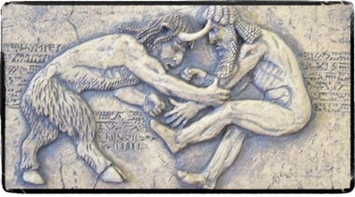
The Sin of the Watchers
Swore an oath to violate God’s order.
They descended from heaven to earth on Mt. Hermon.
Sexually defiled women, producing giants.
Taught occult knowledge, weapon making, and how to make women sexually seductive.
Results in
Occult magic, witchcraft, sorcery
War
Turning women into sex objects
Corrupting humans and animals
Giants consumed natural resources, drank human blood, and ate human flesh.

Slide 31
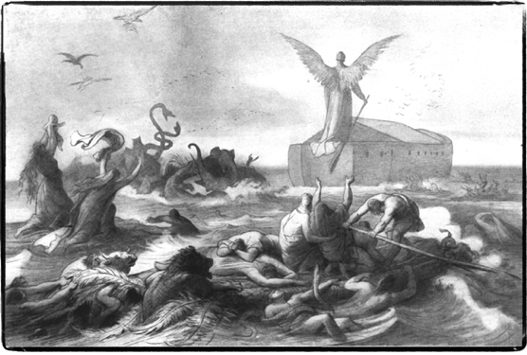
God’s Divine Intervention
And Yahweh said, “My Spirit shall not abide with humankind forever in that he is also flesh. And his days shall be one hundred and twenty years.” …
And Yahweh saw that the evil of humankind was great upon the earth, and every inclination of the thoughts of his heart was always only evil.
And Yahweh regretted that he had made humankind on the earth, and he was grieved in his heart.
And Yahweh said, “I will destroy humankind whom I created from upon the face of the earth, from humankind, to animals, to creeping things, and to the birds of heaven, for I regret that I have made them.”
But Noah found favor in the eyes of Yahweh.
Genesis 6:3-8

Slide 32
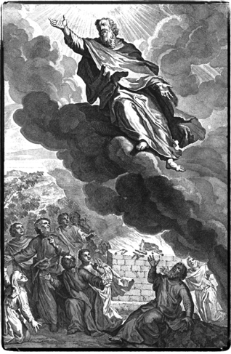
New Testament Perspectives
on the Sin of the Watchers
And many will follow their licentious ways, because of whom the way of truth will be reviled….
For if God did not spare the angels who sinned, but held them captive in Tartarus with chains of darkness and handed them over to be kept for judgment, and did not spare the ancient world, but preserved Noah, a proclaimer of righteousness, and seven others when he brought a flood on the world of the ungodly,…
especially those who go after the flesh in defiling lust and who despise authority.
2 Peter 2:2–10

Slide 33
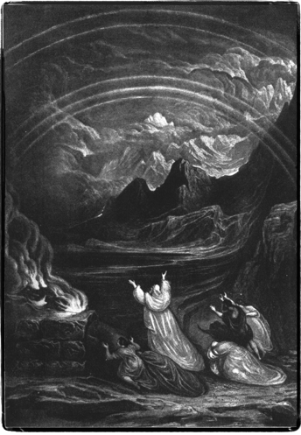
BAPTISM
Celebrating Jesus’ Victory over the Watchers
For Christ also suffered once for sins,
the just for the unjust,
in order that he could bring you to God,
being put to death in the flesh,
but made alive in the spirit,
in which also he went and proclaimed to the spirits in prison, who were formerly disobedient, when the patience of God waited in the days of Noah, while an ark was being constructed, in which a few—that is, eight souls—were rescued through water.
And also, corresponding to this, baptism now saves you, not the removal of dirt from the flesh, but an appeal to God for a good conscience through the resurrection of Jesus Christ, who is at the right hand of God, having gone into heaven, with angels and authorities and powers having been subjected to him.
1 Peter 3:18–22

Slide 34
Why do bad things happen?
1. Wicked spirits rebelling against God
2. When we put our desires first
3. When we believe and act on lies about our identity and destiny
4. When we turn to other spirits instead of God for knowledge
5. Natural chaotic forces (Leviathan)
Who can fix this?

Slide 35
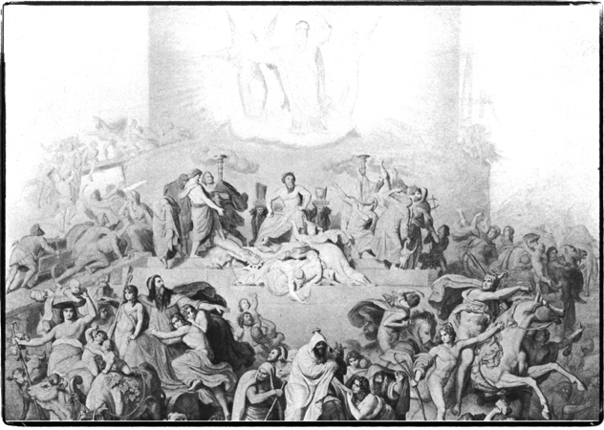
GOD’S STORY
Discovering YOUR Part in God’s SUPERNATURAL PLAN
TOWER OF BABEL
Earth Invading Heaven

Slide 36
Leviathan
Sons of God
The Word
Time
Eden
Stolen Identity
Sons of God Descend
Giants
The Flood
The Promise
On that day, Yahweh will punish with his cruel, great and strong sword Leviathan, the fleeing serpent, and Leviathan, the twisting serpent, and he will kill the sea monster that is in the sea. Isaiah 27:1

Slide 37
Nimrod: The First Emperor
And Cush fathered Nimrod. He was the first on earth to be a mighty warrior (giant?). He was a mighty hunter before Yahweh….
Now, the beginning of his kingdom was Babel,… in the land of Shinar. From that land he went out to Assyria
Genesis 10:8–11
Babel means “Gate to God.”
Shinar (Babylon) and Assyria become the great enemies of Israel and God

Slide 38
Tower of Babel
Now the whole earth had one language and the same words. And as people migrated from the east they found a plain in the land of Shinar and settled there. …
And they said, “Come, let us build ourselves a city and a tower whose top reaches to the heavens. And let us make a name for ourselves, lest we be scattered over the face of the whole earth.”
Then Yahweh came down to see the city and the tower that humankind was building. And Yahweh said, “Behold, they are one people with one language, and this is only the beginning of what they will do. So now nothing that they intend to do will be impossible for them. Come, let us go down and confuse their language there, so that they will not understand each other’s language.”
So Yahweh scattered them from there over the face of the whole earth, and they stopped building the city…. Genesis 11:1–9

Slide 39
The Garden of Eden
Heaven on Earth
Eden
GOD’S SPACE
OUR SPACE

Slide 40
Their Goal: Bring Heaven to Earth
Tower of Babel
God’s space
Our Space

Slide 41
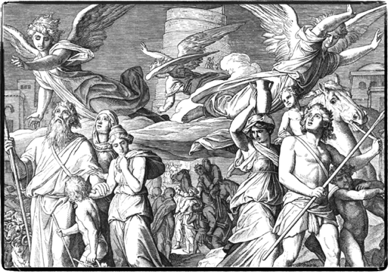
God’s Response: Disinheritance
When the Most High gave to the nations their inheritance,
when he divided mankind,
he fixed the borders of the peoples
according to the number of the sons of God.
Deuteronomy 32:8 ESV

Slide 42
The Domain of Darkness
…who has rescued us from the domain of darkness and transferred us to the kingdom of the Son he loves, in whom we have the redemption, the forgiveness of sins,
Colossians 1:13

Slide 43
The Problem of Evil
God stands in the divine assembly;
he administers judgment in the midst of the gods.
“How long will you judge unjustly
and show favoritism to the wicked? Selah
Judge on behalf of the helpless and the orphan;
provide justice to the afflicted and the poor.
Rescue the helpless and the needy;
deliver them from the hand of the wicked.”
They do not know or consider.
They go about in the darkness,
so that all the foundations of the earth are shaken.
I have said, “You are gods,
and sons of the Most High, all of you.
However, you will die like men,
and you will fall like one of the princes.”
Rise up, O God, judge the earth,
because you shall inherit all the nations.
Psalm 82
Wicked spirits favor injustice
Oppress the helpless, needy, sick and poor
Refuse to save the suffering from the wicked
If God changes immortal beings into mortals as punishment, will God change mortal beings into immortals to replace them?

Slide 44
Why do bad things happen?
1. Wicked spirits ruling the nations
2. Putting our desires first
3. Believing lies about ourselves
4. Turning to other spirits instead of God for knowledge
5. Natural chaotic forces (Leviathan)
Who must fix this?

Slide 45
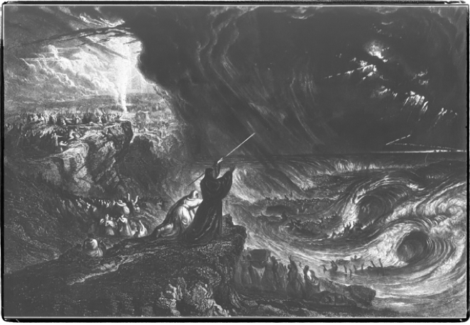
GOD’S STORY
Discovering YOUR Part in God’s SUPERNATURAL PLAN
The Kingdom of Israel

Slide 46
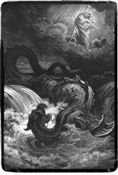
The Story So Far…
Domain of Darkness
Leviathan
Sons of God
The Word
Time
Eden
Stolen Identity
Sons of God
Giants
The Flood
Tower of Babel
“Gods” of the Nations
The Promise
On that day, Yahweh will punish with his cruel, great and strong sword Leviathan, the fleeing serpent, and Leviathan, the twisting serpent, and he will kill the sea monster that is in the sea. Isaiah 27:1
Faith

Slide 47
War between God and the “gods”
Domain of Darkness
Cosmic Conflict
Israel / Jews
God’s Space
The Temple
Our Space
Tower of Babel
Abraham
Moses
Invasion
Kingdom
of
Israel
Law
The Nation of Israel against the Domain of Darkness
Faith

Slide 48
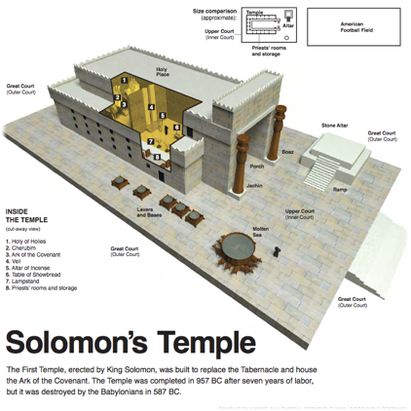
Creation of Israel
“…And all families of the earth will be blessed in you.” Ge 12:3
ca 2090 B.C.
ca 1447 B.C.
And now if you will carefully listen to my voice and keep my covenant, you will be a treasured possession for me out of all the peoples, for all the earth is mine, but you, you will belong to me as a kingdom of priests and a holy nation.
Exodus 19:5–6
ca 957 B.C.
And Solomon held a feast at that time of seven days. And Solomon finished the house of Yahweh and the house of the king. 2 Ch 7:8,11
He had built it in seven years. Solomon built his house over thirteen years, and he finished all of his house. 1 Kings 6:38–7:1

Slide 49
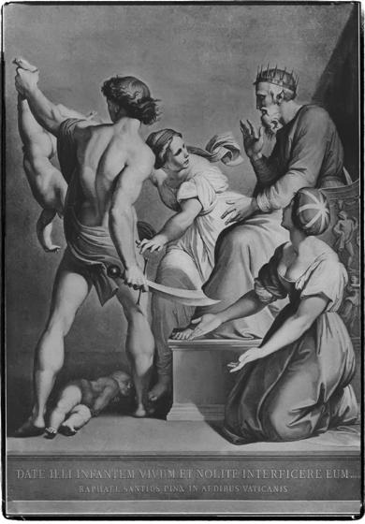
The Kingdom of God on Earth?
Judah and Israel were as many as the sand which is on the seashore in abundance, eating and drinking and rejoicing!
Now Solomon was ruling over all the kingdoms… and he had peace from every side all around.
Judah and Israel lived in security, each man under his vine and under his fig tree,..
Now Solomon had forty thousand stalls of horses for his war chariots and twelve thousand horsemen…
God gave wisdom to Solomon and very great discernment, as well as breadth of understanding,…
The wisdom of Solomon was greater than the wisdom of all the people of the east and more than all the wisdom of Egypt…
He spoke three thousand proverbs, and his songs were one thousand and five. He spoke concerning the trees, from the cedar which is in Lebanon up to the hyssop which grows on the wall; he also spoke concerning the animals, concerning the birds, concerning the creeping things, and concerning the fish.
They came from all the nations to hear the wisdom of Solomon; from all the kings of the earth who had heard of his wisdom.
1 Ki 4:19–5:1

Slide 50
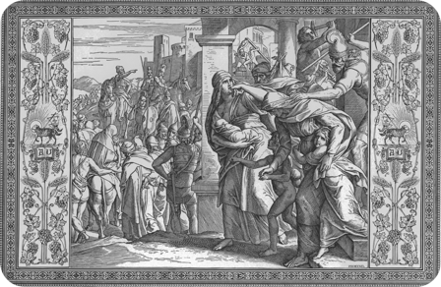
The Kingdom Fails
Domain of Darkness
Assyria and Babylon
Cosmic Conflict
Jews into the nations
Tower of Babel
Israel / Jews
Temple
Destroyed
Abraham
Moses
Invasion
Kingdoms
of
Israel/Judah
Law
Faith

Slide 51
Why do bad things happen?
1. Wicked spirits ruling the nations
2. Putting our desires first
3. Believing lies about ourselves
4. Following other spirits instead of God
5. Natural chaotic forces
Who can fix this?

Slide 52
GOD’S STORY
Discovering YOUR Part in God’s SUPERNATURAL PLAN
The Cloud Rider

Slide 53
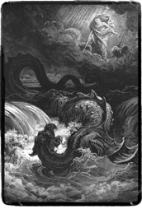
The Story So Far…
Domain of Darkness
Leviathan
Sons of God
The Word
Time
Eden
Stolen Identity
Sons of God
Giants
The Flood
Tower of Babel
Gods of the Nations
Creation
of
Israel
Exile of Israel
The Promise
On that day, Yahweh will punish with his cruel, great and strong sword Leviathan, the fleeing serpent, and Leviathan, the twisting serpent, and he will kill the sea monster that is in the sea. Isaiah 27:1
Faith

Slide 54
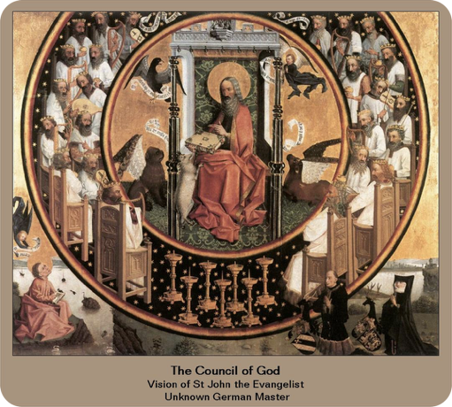
The Divine Council
…I saw Yahweh sitting on his throne with all the hosts of heaven standing beside him from his right hand and from his left hand.
And Yahweh said, ‘Who will entice Ahab so that he will go up and fall at Ramoth-Gilead?’
Then this one was saying one thing and the other one was saying another.
Then a spirit came out and stood before Yahweh and said, ‘I will entice him,’ and Yahweh said to him, ‘How?’
He said, ‘I will go out and I will be a false spirit in the mouth of all his prophets.’
And he said, ‘You shall entice and succeed, go out and do so.’…
1 Ki 22:19–23.

Slide 55
The Divine Council
God stands in the divine assembly;
he administers judgment in the midst of the gods…
I have said, “You are gods,
and sons of the Most High, all of you.
However, you will die like men,
and you will fall like one of the princes.”
Rise up, O God, judge the earth,
because you shall inherit all the nations.
Psalm 82

Slide 56
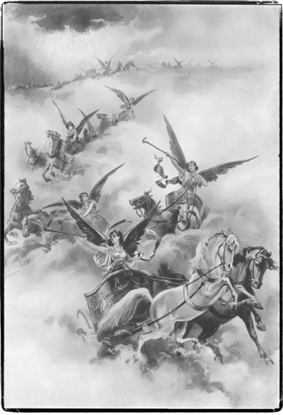
Yahweh Rides the Clouds
There is no one like God, O, Jeshurun,
who rides through the heavens to your help,
and with his majesty through the skies.
Deut 33:26
O kingdoms of the earth, sing to God;…
to the one who rides in the highest heavens of old…. His majesty is over Israel,
and his strength is in the clouds. Ps 68:32–34
Bless Yahweh, O my soul…
who makes clouds his chariot,
who rides on the wings of the wind,…
Ps 104:1–4
Look! Yahweh is riding on a swift cloud
and is coming to Egypt… Is 19:1

Slide 57
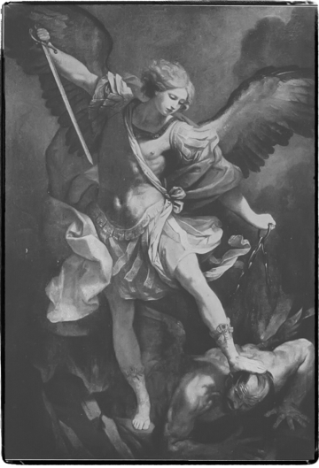
The Son of Man Rides the Clouds
I continued watching until thrones were placed and an Ancient of Days sat; his clothing was like white snow and the hair of his head was like pure wool and his throne was a flame of fire and its wheels were burning fire. A stream of fire issued forth and flowed from his presence; thousands upon thousands served him and ten thousand upon ten thousand stood before him. The judge sat, and the books were opened…
I continued watching in the visions of the night, and look, with the clouds of heaven one like a son of man was coming, and he came to the Ancient of Days, and was presented before him.
And to him was given dominion and glory and kingship that all the peoples, the nations, and languages would serve him; his dominion is a dominion without end that will not cease, and his kingdom is one that will not be destroyed.
Daniel 7:9–14

Slide 58
Jesus: Yahweh in the Divine Council
“We are not going to stone you concerning a good deed, but concerning blasphemy, and because you, although you are a man, make yourself to be God!”
Jesus answered them, “Is it not written in your law, ‘I said, “You are gods”? If he called them ‘gods’ to whom the word of God came—and the scripture cannot be broken—do you say about he whom the Father set apart and sent into the world, ‘You are blaspheming,’ because I said, ‘I am the Son of God’? If I do not do the deeds of my Father, do not believe me. But if I am doing them, even if you do not believe me, believe the deeds, so that you may know and understand that the Father is in me and I am in the Father.” So they were seeking again to seize him, and he departed out of their hand.
John 10:33–39

Slide 59
Jesus: Yahweh in the Clouds
But Jesus was silent. And the high priest said to him, “I put you under oath by the living God, that you tell us if you are the Christ, the Son of God!”
Jesus said to him, “You have said it. But I tell you, from now on you will see the Son of Man sitting at the right hand of the Power and coming on the clouds of heaven.”
Then the high priest tore his robes, saying, “He has blasphemed! What further need do we have of witnesses? Behold, you have just now heard the blasphemy! What do you think?”
Matthew 26:62–66

Slide 60
Jesus: Yahweh on the Cross

Slide 61
Jesus the Resurrected King

Slide 62
GOD’S STORY
Discovering YOUR Part in God’s SUPERNATURAL PLAN
The Kingdom of God

Slide 63
The Kingdom of God invades Earth
God Takes Back the Nations
God’s Space
Sin of
Adam
Sin of
The Watchers
Tower of
Babel
Israel/ Judea
Exile
Domain of Darkness

Slide 64
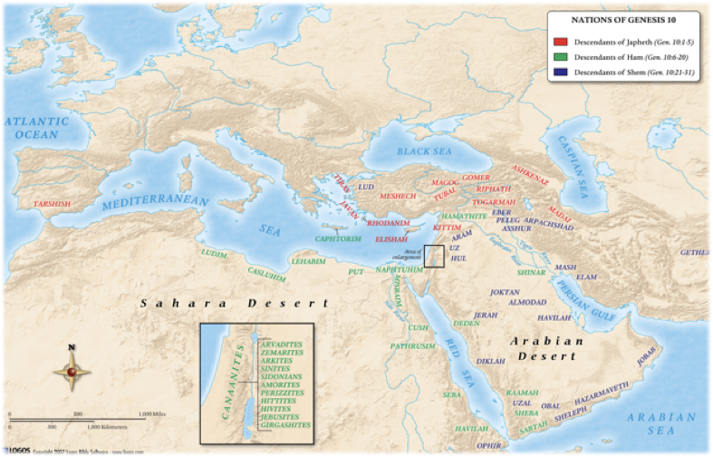
Babel: Scattering the Nations
When the Most High gave to the nations their inheritance,
when he divided mankind,
he fixed the borders of the peoples
according to the number of the sons of God... Deut 32:8 ESV

Slide 65
The Kingdom of God is at Hand!
The Spirit of the Lord is upon me, because of which he has anointed me to proclaim good news to the poor. He has sent me to proclaim release to the captives, and recovery of sight to the blind,
to send out in freedom those who are oppressed,
to proclaim the favorable year of the Lord.”
Luke 4:18–19
Kingdom of God
Holy Spirit brings justice
Saves the helpless, needy, sick and poor
Sets free those suffering from the wicked
Domain of Darkness
Wicked spirits favor injustice
Oppress the helpless, needy, sick and poor
Refuse to save the suffering from the wicked

Slide 66
Jesus Revealed
And after six days, Jesus took along Peter and James and John, and led them to a high mountain by themselves alone.
And he was transfigured before them, and his clothing became radiant—extremely white, like no cloth refiner on earth can make so white.
And Elijah appeared to them together with Moses, and they were talking with Jesus.
And Peter answered and said to Jesus, “Rabbi, it is good that we are here! And let us make three shelters, one for you and one for Moses and one for Elijah.” (For he did not know what he should answer, because they were terrified.)
And a cloud came, overshadowing them, and a voice came from the cloud, “This is my beloved Son. Listen to him!” And suddenly, looking around, they no longer saw anyone with them but Jesus alone.
Mark 9:2–8

Slide 67
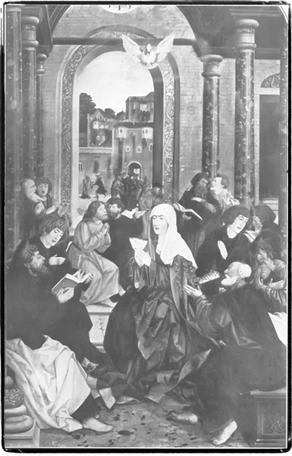
Reclaiming the Nations
And when the day of Pentecost had come, they were all together in the same place. And suddenly a sound like a violent rushing wind came from heaven and filled the whole house where they were sitting. And divided tongues like fire appeared to them and rested on each one of them. And they were all filled with the Holy Spirit and began to speak in other languages as the Spirit gave them ability to speak out.
Now there were Jews residing in Jerusalem, devout men from every nation under heaven. And when this sound occurred, the crowd gathered and was in confusion, because each one was hearing them speaking in his own language.
And they were astounded and astonished, saying, “Behold, are not all these who are speaking Galileans? And how do we hear, each one of us, in our own native language? Parthians and Medes and Elamites and those residing in Mesopotamia, Judea and Cappadocia, Pontus and Asia, Phrygia and Pamphylia, Egypt and the parts of Libya toward Cyrene, and the Romans who were in town, both Jews and proselytes, Cretans and Arabs—we hear them speaking in our own languages the great deeds of God!” And all were amazed and greatly perplexed, saying to one another, “What can this mean?”
Acts 2:1–12

Slide 68
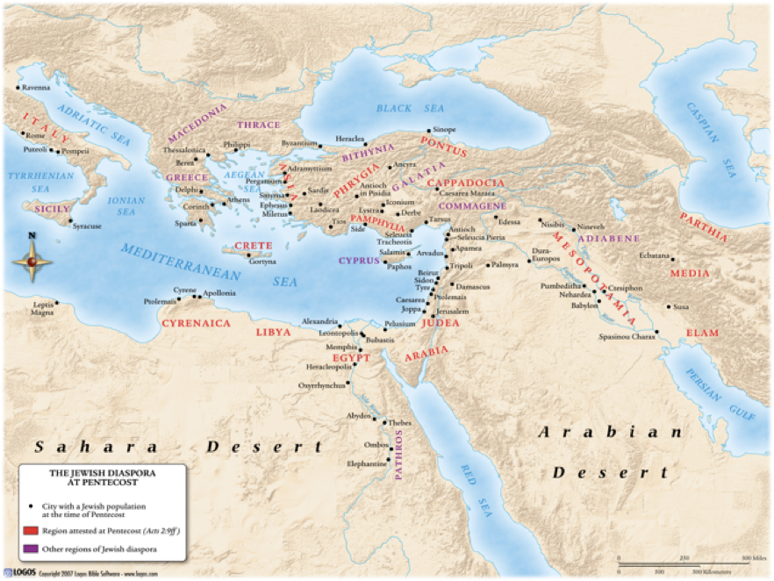
Reclaiming the Nations
“…Parthians and Medes and Elamites and those residing in Mesopotamia, Judea and Cappadocia, Pontus and Asia, Phrygia and Pamphylia, Egypt and the parts of Libya toward Cyrene, and the Romans who were in town, both Jews and proselytes, Cretans and Arabs…”

Slide 69
The Tension of the Kingdoms
God Takes Back the Nations
Kingdom of God
Conflict
Sin of
Adam
Sin of
The Watchers
Tower of
Babel
Domain of Darkness

Slide 70
The Problem
The Solution
1. Jesus Christ taking back the nations
2. Making Jesus the Lord of our lives
3. Trusting what Jesus says about us
4. Trusting only the Holy Spirit
5. Jesus destroys Leviathan
1. Wicked spirits ruling the nations
2. Putting our desires first
3. Believing lies about ourselves
4. Trusting demonic spirits
5. Leviathan

